Slide 1
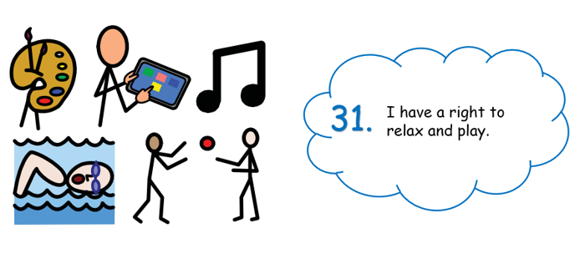
Right of the week
this means…

Slide 2
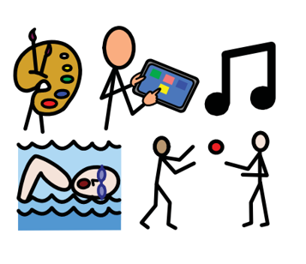
Right of the week
This means you have the right to play, relax, and join in a wide range of cultural, artistic, and other recreational activities.
A great opportunity to show your artistic talent is in the Harvest and Christmas Church Services that we have coming up. We will be asking for speakers and singers in the coming weeks.

Slide 3


