Slide 1
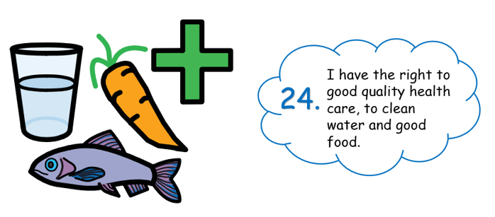
Right of the week
this means…

Slide 2
Right of the week
This means you have the right to good quality health care and to clean water.
You have the right to nutritious food and a clean environment so that you can stay healthy.
Rich countries should help poorer countries achieve this.

Slide 3


