Slide 1

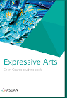
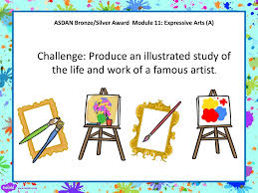
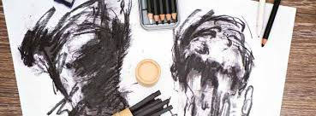
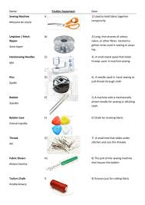
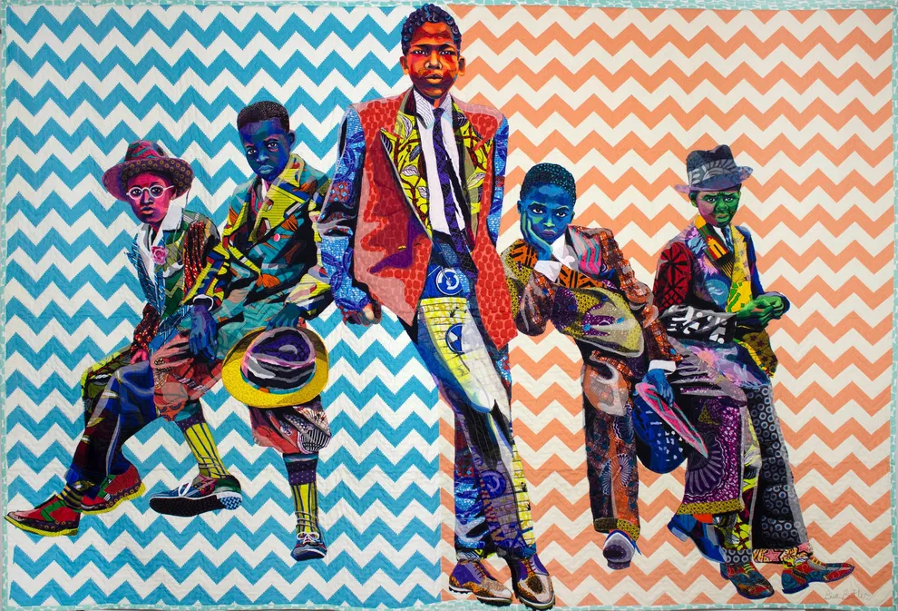



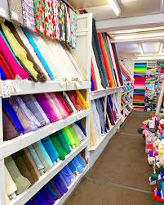

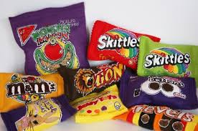

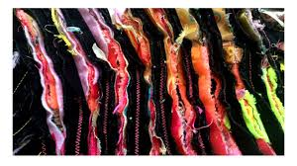
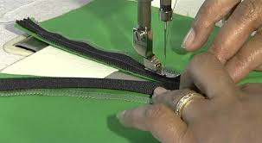
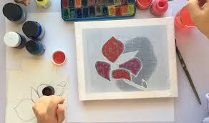
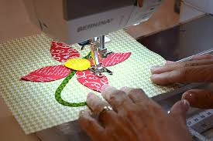
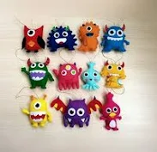
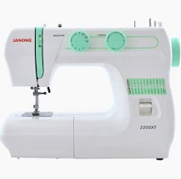

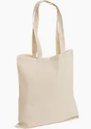
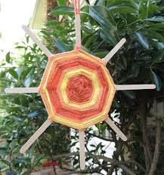
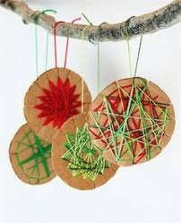
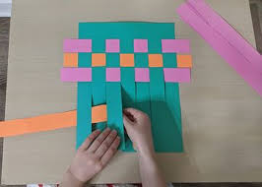
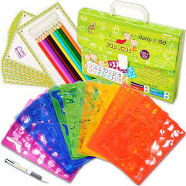
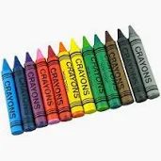

ASDAN Expressive Art Short Course offers exciting and rewarding activities to develop skills and knowledge through all forms of expressive arts.
KS5
NCFE Level 2
This qualification aims to extend and further develop learners' skills and to extend learners' knowledge and understanding of the creative craft process.
YEAR
11
Portfolio created
Students will complete a final piece of their choice to complete their NCFE course.
Students will be researching recycling and create a useable item.
Students will learn about the properties of fabrics.
Students will be able to use visual language to create an idea.
Students will look at different textile artists
YEAR
Students will visit fabric shops to be able to be able to explore materials and tools.
10
To practice a variety of techniques in depth.
Discuss NCFE qualification and how to create a portfolio.
Students will be looking at mood boards.
A
Students will learn how to manipulate fabrics with different techniques.
Students will have made simple items throughout this year.
Using their prior knowledge students learn how to embellish fabric
YEAR
Students will be learning the technique of machine embroidery.
9
.Using their prior knowledge student will look at surface decoration.
Students will learn different fabric marking techniques.
Using felt students will learn to make simple items.
Students will learn how to insert a zip.
Students will learn about the technique Applique.
YEAR
8
YEAR
Using their knowledge students will make simple useable items.
Students will use the machine to sew straight lines on paper, then on fabric finally experimenting with the stitches available.
7
Students will learn how a sewing machine works. Incorporating the health and safety when using a machine.
YEAR
Weaving with paper
6
Textiles helps children develop fine motor skills, problem-solving skills, self-esteem, imagination, discipline, and patience.
.
YEAR
5
Painting
Colouring
Using equipment correctly
TEXTILES LEARNING JOURNEY – GRANGE PARK SCHOOL

